Slide 1
Patient Stroke Analysis in Python
By Mangesh Rai

Slide 2

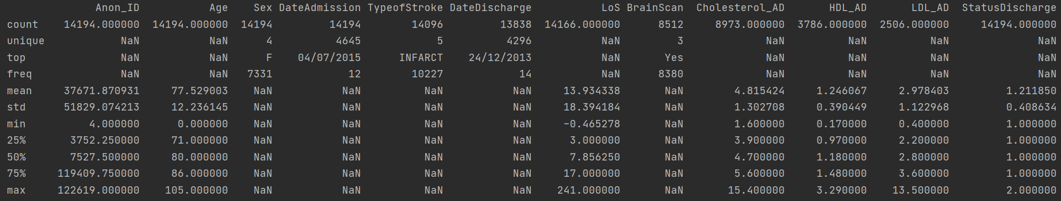
Data Set Summary
Anon-ID
Age – Age of Patient
Sex - Male or Female
DateAdmission – Date when patient was admitted into the hospital
Type of Stroke – Infarction, Bleed or Subarachnoid
DateDischarged – Date when patient was discharged
LoS – Length of stay in hospital
BrainScan – Whether a brain scan was conducted or not
Cholesterol_AD – Cholesterol level at admission
HDL_AD – HDL level at admission
LDL_AD – LDL level at admission
StatusDischarge – 1 = Alive 2=Dead

Slide 3
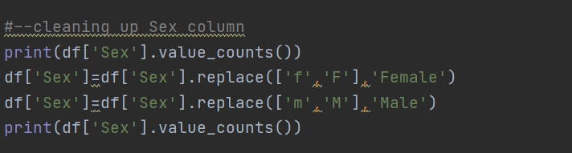
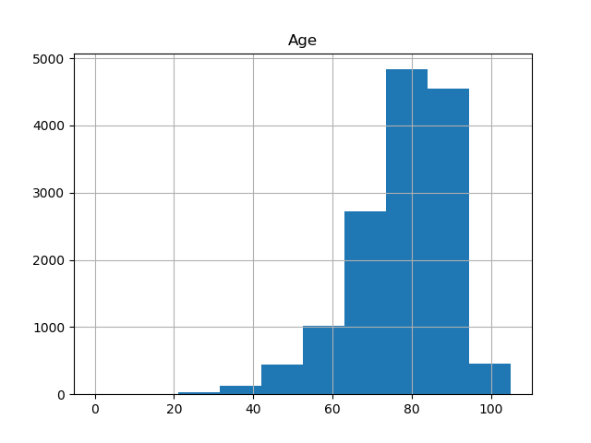
Age of Patients
Cleaning up Sex column;
Average age of all patients is 77.52
Standard deviation is 12.24
Median age = 80
Almost follows a Normal Distribution

Slide 4
Age of Male and Female Patients
Mean age of Female patients – 80.13
Mean age of Male patients – 74.74
51.70% of patients are Males
48.30% of patients are Females

Slide 5
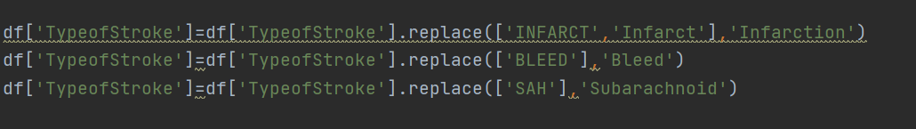
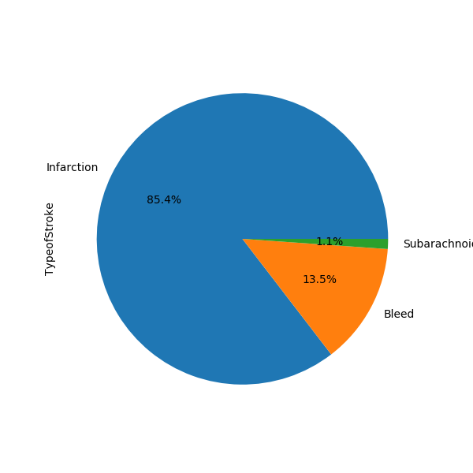
Type of Strokes
Cleaning up TypeofStroke column;
Infarction strokes make up 85.4%
Bleed strokes make up 13.5%
Subarachnoid make up a small 1.1%

Slide 6
Survival Percentage of Strokes
Bleed strokes seem to be the most lethal with 36.8% of patience dying
Subarachnoid strokes 2nd lethal with 29.9% patience dying
Infarction strokes the least dangerous with 81.3% of patience surviving.

Slide 7
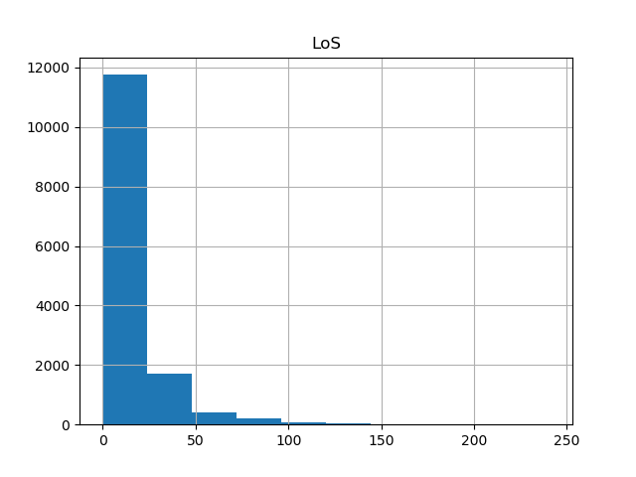
Length of Stay
On average patience are staying around 14 days with standard deviation of 13 days.
Subarachnoid patience tend to have quick turnaround and stay between 3 to 4 days only.

Slide 8
Brain Scan Survival
Note only 8512 entries where made in the BrainScan meaning 5685 entries are blank.
Patience who have a brain scan have a greater chance of surviving than those patience who do not.
Patience are 3.51 times likely to survive if a Brain Scan is done.
Missing values could change the results

Slide 9
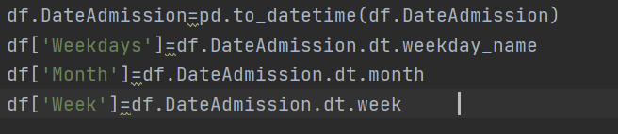
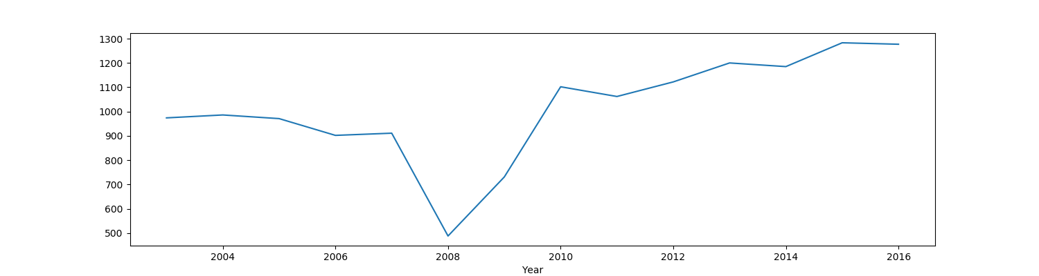
Time Series Analysis by Year
Adding in Year, Month, week and weekday column.
There was a sharp fall in 2008(could be due to missing data)
Over 900 patience per year being admitted to hospital for strokes

Slide 10
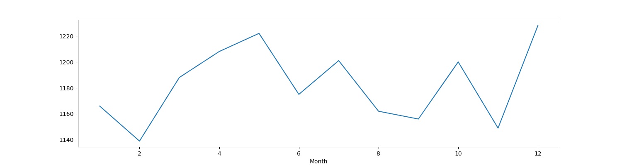
Time Series Analysis by Month
Months April, May, July, October and December tend to be the most busiest for Strokes.
Note this is 14 years worth of data

Slide 11
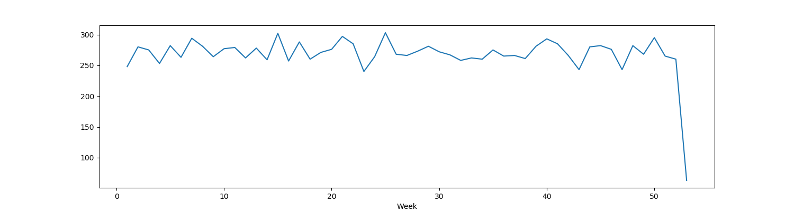
Time Series Analysis by Week
The graph shows there are over 220 patience being emitted to hospital every week for strokes. (15.7)
Weekly emissions tend to stay between 220 and 300 patience per week
No real pattern observed.

Slide 12
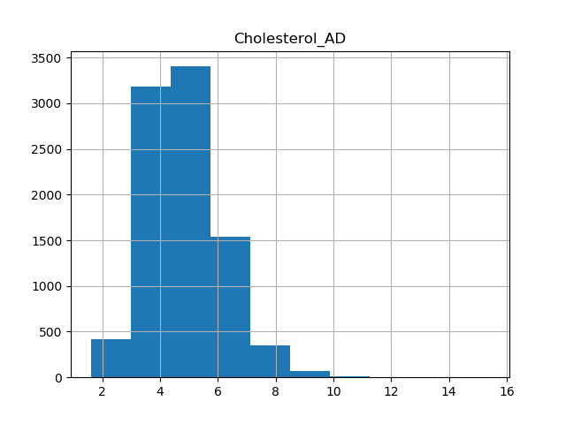
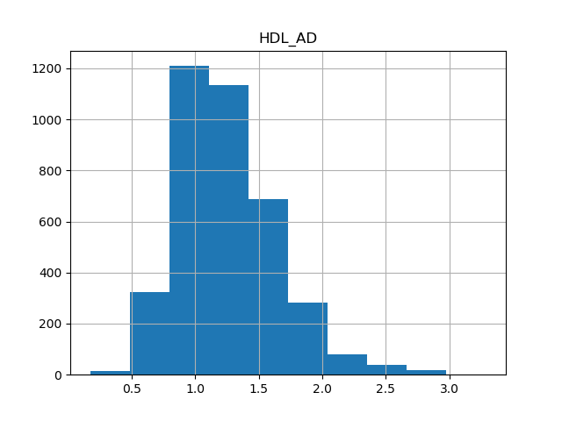
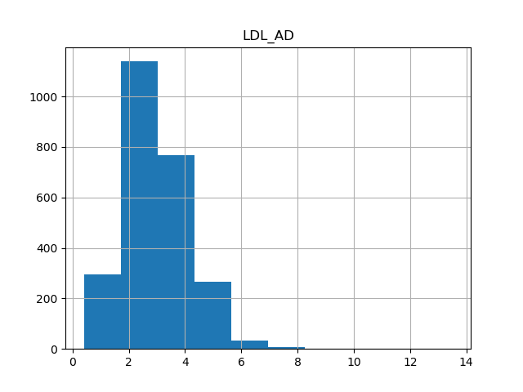
Cholestorel_AD, HDL_AD and LDL_AD Levels at Admission
Average Cholesterol_AD level is 4.82.
Std is 1.3
Note only 8973 entries, missing 5221.
Average HDL_AD level is 1.25.
Std is 0.40.
Note only 3786 entries, missing 10408
Average LDL_AD level is 2.98
Std is 1.12
Note only 2506 entries, missing 11688

Slide 13
Male and Female Cholesterol_AD level
Cholesterol_AD levels in females are higher than males
Healthy level of cholesterol is less than 5.
Both males and females have high Cholesterol_AD levels.
HDL_AD levels in females are higher than males
Healthy level of HDL is above 1.
Both males and both have low HDL_AD levels.
LDL_AD in females are higher than males.
Healthy level of LDL is 3 and below.
Both males and females have high LDL_AD levels.

Slide 14

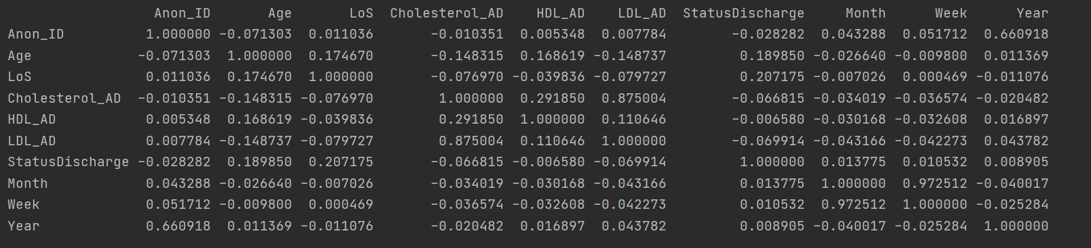
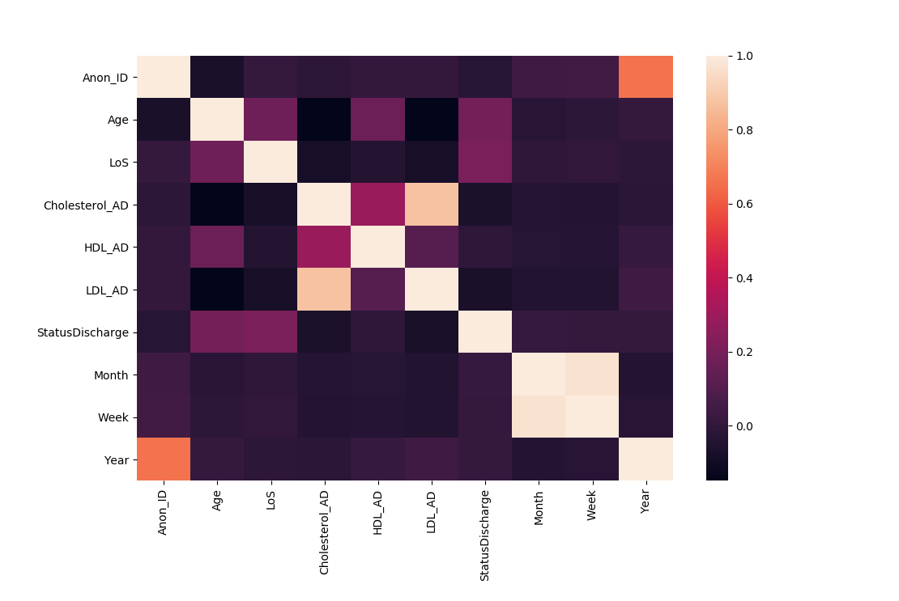
Correlation of dataset
Dropping all NA values, only 1231 rows remain.
Pairwise correlation of dataset
Heatmap of correlation

Slide 15
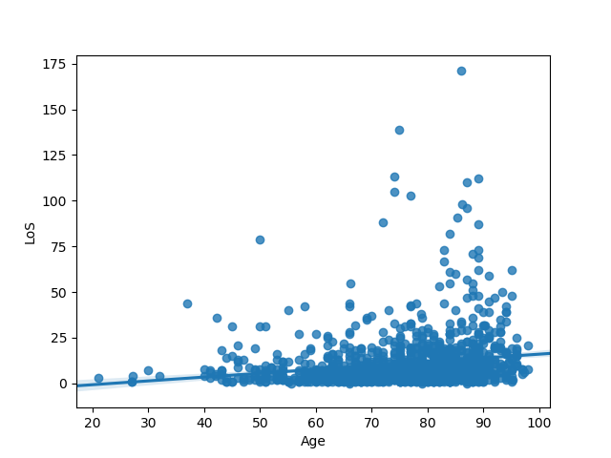
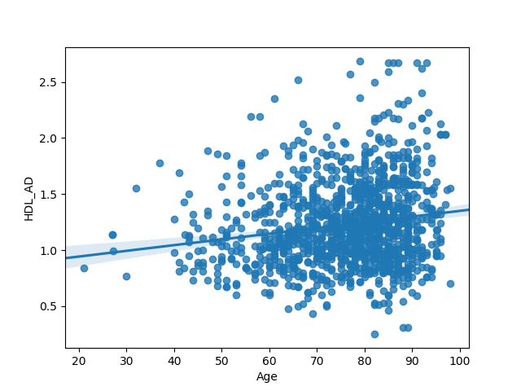
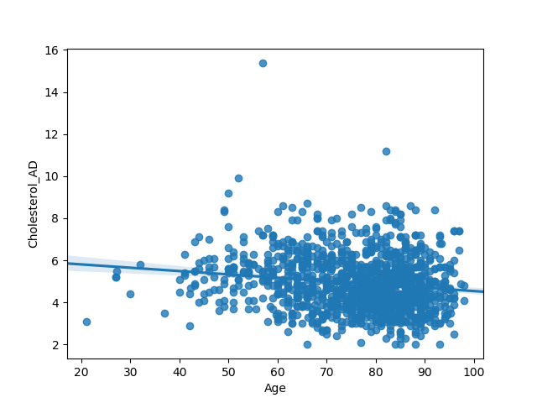
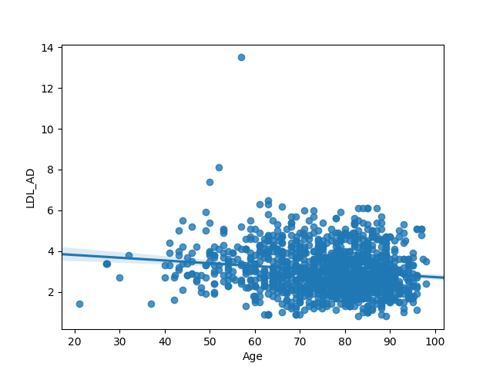
Linear Regression of Age vs LoS, Cholestorol_AD, HDL_AD and LDL_AD
Null Hypothesis: Age has no effect on LoS, Cholestorol, HDL_AD and LDL_AD
Alternative Hypothesis: Age does have an effect
R^2 =0.03
P-Value= 6.84373799593667e-10
Gradient = 0.21
Y-Intercept = -4.88
R^2=0.03
P-Value=
2.636669637713897e-09
Gradient = 0.005
Y-Intercept = 0.84
R^2 =0.02
P-Value
1.7192421914070178e-07
Gradient = -0.02
Y-Intercept = 6.12
R^2=0.02
P-Value=
1.5847766935483104e-07
Gradiant = -0.013
Y-Intercept = 4.08

Slide 16
Conclusion
As P-Value is below 0.05 is all cases we can say Age does effect LoS, Cholesterol_AD, HDL_AD and LDL_AD levels.
R^2 value is low for all cases meaning these model should not be used to make accurate predictions.
For every increase in age LoS increases by 0.21.
For every increase in age Cholesterol_AD decreases by 0.02.
For every increase in age HDL_AD increase by 0.005
For every increase in age LDL_AD decreases by 0.013

Slide 17
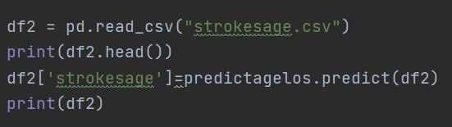
Using Linear Regression Model to Predict values
This function allows you to quickly read in a separate file with variables you want to predict with your model.

Slide 18
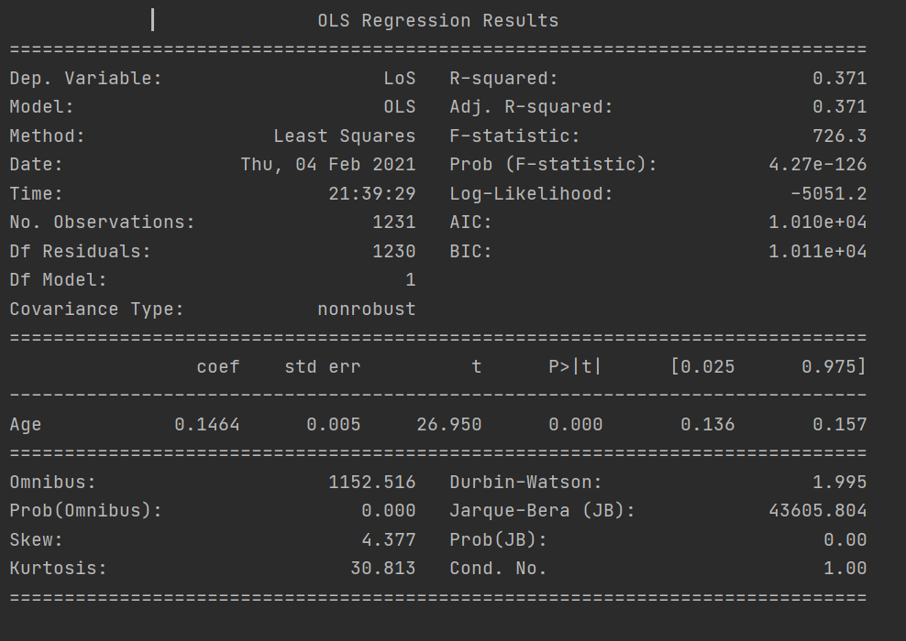
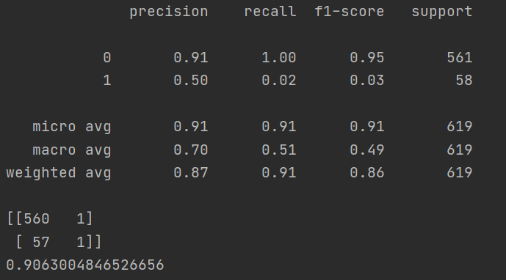
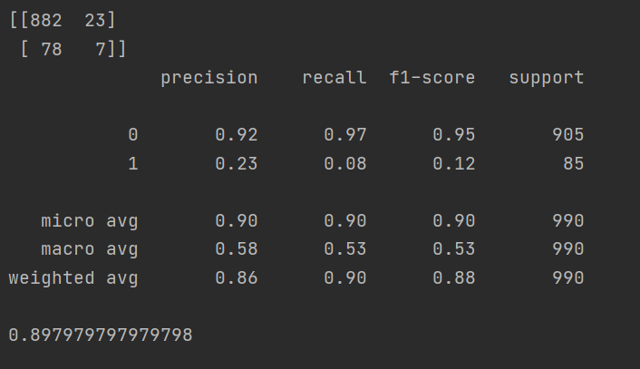
Other Statistical Functions in Python
Accuracy score tells you how accurate your model is based on the confusion matrix.
Precision tells you true positive is correct 91% of the time for people who survived and 50% for people who died.
Ordinary Least Squares Regression
F1-Score is a way of combining precision and recall of a model and is the harmonic mean of both.
Random Forest Classification Report, Confusion Matrix and Accuracy score. 91% Specificity Rate for true negative results.

